Slide 1
ASP.NET Core

Slide 2
ASP.NET Core Fundamentals
Controllers in the MVC Framework
Notes:
Controllers in the MVC Framework
The MVC Framework gets its name from a popular design pattern, which we will also learn about.
We'll go into the mechanics of how to use controllers to process HTTP requests.
We'll see that controllers can produce text, serialize objects into JavaScript, and render HTML to the client.

Slide 3
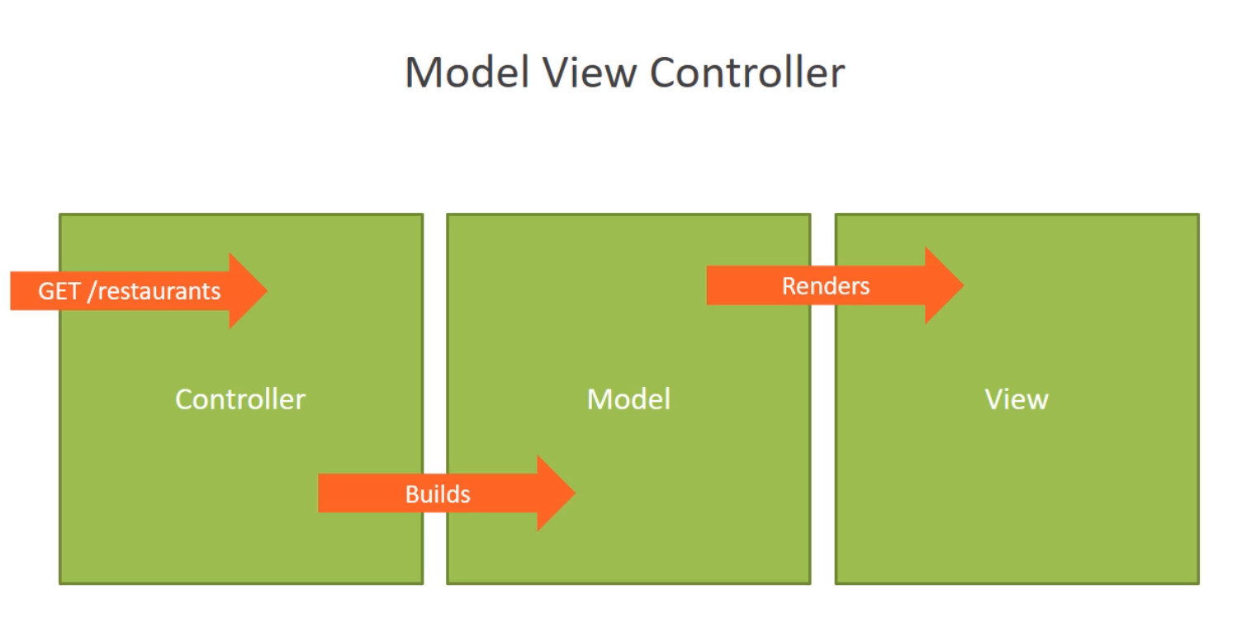
The Model View Controller Design Pattern
Separation of concerns
Notes:
The Model View Controller Design Pattern
The MVC Framework is named for the MVC design pattern, where the M stands for model, the V stands for view, and C is for controller.
The MVC design pattern is a popular design pattern for the user interface layer of a software application, and in larger applications you typically combine a model view controller UI layer with other design patterns in an application, like data access patterns and messaging patterns, to build the full application stack.
In MVC, it is the controller that receives the initial HTTP request.
We'll see how to map an HTTP request to a method on a controller class, but once you’re inside of that controller method, it is the controller's job to figure out how to put together the information that will respond to that HTTP request.
Perhaps the user is pointing their browser to the /restaurants URL of the application and sending an HTTP GET request.
So the user is requesting a list of restaurants, and it's the controller that needs to put together the information to display this list of restaurants.
To do that, the controller can build a model.
The model doesn't know anything about the HTTP request or the controller.
The model is responsible for holding the information that the user wants to see.
So in this case, a list of restaurants, and the model is just another C# class that we can use, perhaps more than one class if it's a complex model.
At this point, if you're building an API layer, the Controller method can simply return the model, and that model will get serialized into XML or JSON or any other format that you need to come up with for your API layer.
But if you need to render HTML and build an HTML page, the controller can now select a view that will render that model.
The view takes the information in the model and it uses it to construct an HTML page, and the HTML is sent back to the client in the HTTP response.
Thus, we've completed an entire HTTP request and response transaction.
And these are the very basics of the MVC design pattern.
We'll be working in each one of these steps in this chapter, and the overall idea is to keep a separation of concerns,
so the controller is responsible for taking a request and building a model.
It's the model that carries the information and logic that we need into the view,
and the view is only responsible for transforming the model into HTML.
Three components, each with their own focus on a specific part of the job.
Now in order for all this to work, we need to find a way to send HTTP request to the right controller, and in ASP. NET MVC, this process is known as routing.
Let's look at how to route requests to different controllers.

Slide 4
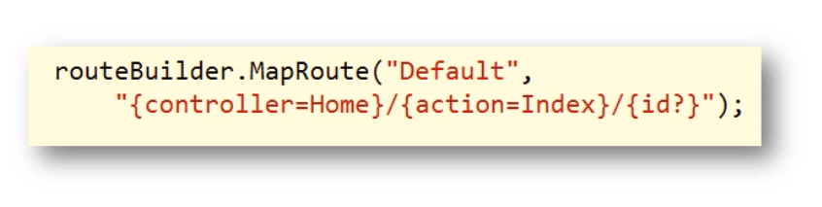
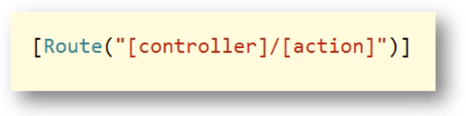
Routing
Convention-based Routing (in Startup.cs)
Attribute-based Routing (on Controller Classes and Methods)
Notes:
Routing
The ASP.NET middleware we installed in the last module needs a way to determine if a given HTTP request should go to a controller for processing or not.
That MVC middleware will make this decision based on the URL and some routing configuration information that we provide.
One way to define this routing configuration is to define the route for our controllers inside of Startup.cs when we add the MVC middleware.
This approach is often referred to as convention-based routing.
We define templates that tell the MVC Framework how to look at a URL and find a controller name and an action name.
Remember the ultimate goal is to take an HTTP request and use information in that request to invoke an action on a controller.
A controller is just a C# class and an action is a public method that's on that class.
Another approach to routing is something we call attribute-based routing.
With attribute-based routing, we use C# attributes on the controller classes and methods themselves to let ASP.NET MVC know when to call a specific method.
Let's look at these two different approaches to routing.

Slide 5
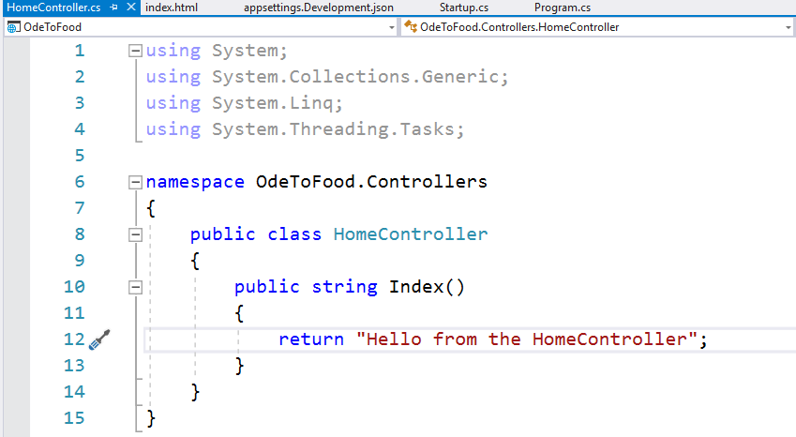
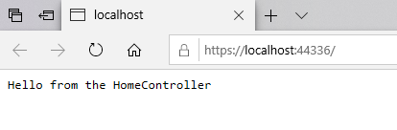
Conventional Routes
Notes:
Conventional Routes
In the previous chapter, we created a simple HomeController with an Index method.
That is an action, and because we have the MVC middleware added to the application, we are able to reach this by going to the root of the website, simply localhost:<portnumber>.

Slide 6
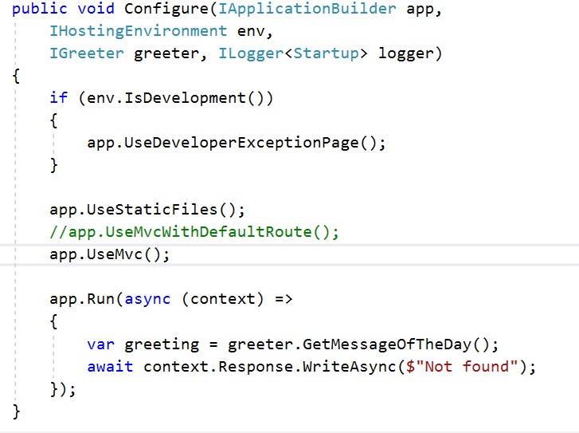
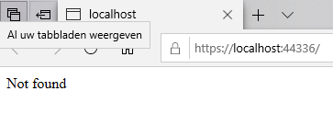
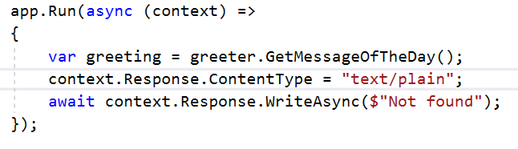
Conventional Routes
Notes:
Conventional Routes
What we want to show you is what is really happening behind the scenes.
Instead of using MVC with the default route, let's simply useMVC, which means there are no routes configured.
The MVC Framework won't really know what to do with the request, it won't know how to map that request to a specific controller.
To prove that, instead of displaying a greeting, let's display the text “Not found”.
When we run, instead of reaching the HomeController, we see the text Not found.
We give you an advanced tip:
When you are writing directly into the response, sometimes you have to be a little bit careful about the HTTP headers that you send back.
Currently what we’re doing is just writing into the response a simple string, and that's all the server will send back to our web browser, and our web browser is trying to interpret what content it is seeing.
It's not getting any help from any HTTP headers about how to interpret this content.
Sometimes when you're working with low-level middleware like this, you'll need to make sure that you set HTTP headers like the status code, and in this case, it is the ContentType, which will tell the web browser exactly how to interpret the response.
We want to use a mime type and tell the browser that the content type it is seeing is text/plain.
If you search the web for mime types, you can see the various content type identifiers that you can use.

Slide 7
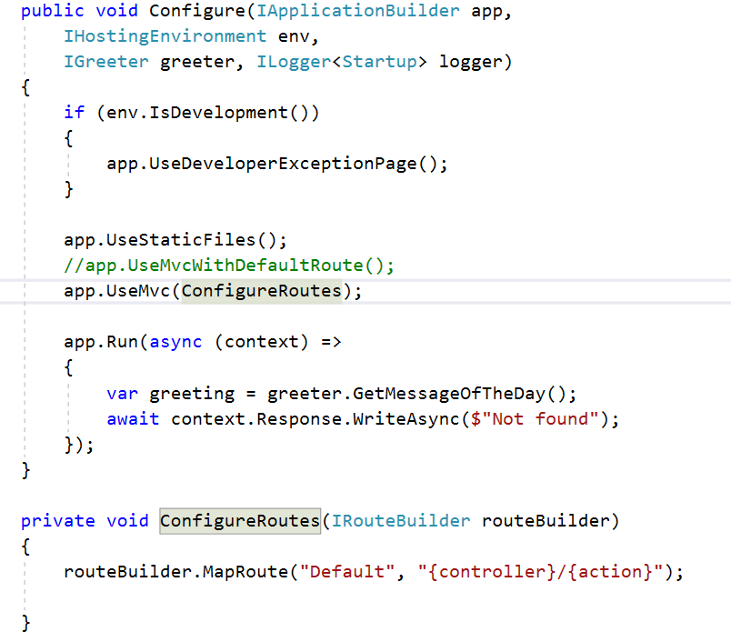
Conventional Routes
Notes:
Conventional Routes
We’re going to use an overload of UseMvc that takes an Action<IRouteBuilder> (This is a delegate and can hold methods that have void as return value and a parameter of type IRouteBuilder).
So I need to give UseMvc a method that it can invoke and pass along a route builder and give me a chance to configure the routes.
In this case, instead of using a lambda expression, let's just generate a named method with Visual Studio.
The name of the method will be ConfigureRoutes. Use Ctrl+period in Visual Studio to generate that method.
You can see we do get a method that takes an IRouteBuilder parameter. We give that a proper name like routeBuilder.
Inside the ConfigureRoutes method using the routeBuilder object, we can define one or more routes for our MVC application.
These are all done with some form of map method.
The method that we want is MapRoute.
With MapRoute, we can define a friendly name for our route, and then a template.
It is the template that the MVC Framework will use to pick apart a URL and try to find information that will allow the MVC Framework to figure out what controller it should instantiate and what method to invoke on that controller object.
So let's say that I want to map an incoming request like /Home/Index to the HomeController's index action.
In that case, we need to tell the MVC Framework that it can find the controller name in the first part of the URL, and the action name in the second part of the URL.
By the way, we don't explicitly have to tell the MVC Framework that the name of the controller ends with the word “controller”; the MVC Framework will just add the name controller to the end of this name.
The URL like /Home/Index should go to the HomeController. To do that, we will specify parameters for this particular route. we specify parameters inside of curly braces.
The name of this parameter is controller. And this tells the MVC Framework that the first part of the URL will contain the name of the controller.
The second segment of the URL will contain the action name.
So given a URL like /Home/Index, the MVC Framework will know the controller name is Home, so look for a class named HomeController, and then the action name is Index.
Let’s find an Index method on that controller,

Slide 8
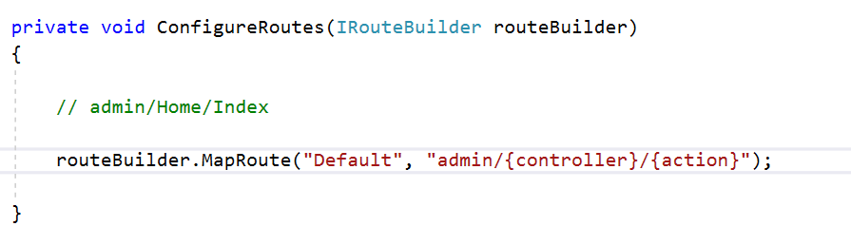
Conventional Routes
Notes:
Conventional Routes
We can also have some literal text in here.
So let's say that we wanted only request for admin/Home/Index to go to that HomeController. Our template would look like admin/controller name /action.

Slide 9
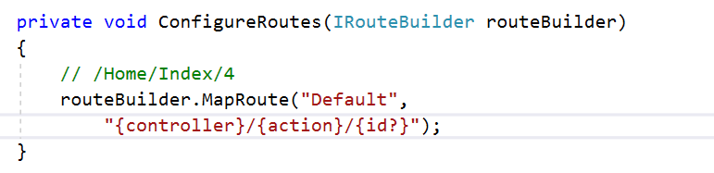
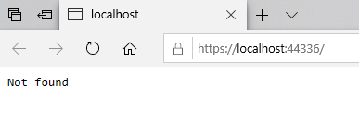
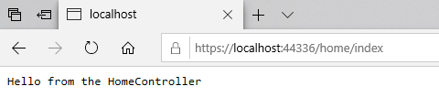
Conventional Routes
Notes:
Conventional Routes
We can define multiple routes with the routeBuilder.
For this course, we'll just be using this single conventional route.
We can also specify other arbitrary parameters.
For example, if we’re creating a controller that has to look up a record in the database. I
n that case, the controller's going to need some sort of identifier that it can retrieve and use that identifier to query the database.
Inside of the route template if you see another slash and some additional information like the number 4, treat that as an id parameter.
We'll see later in the course how a controller action can receive this parameter and then use that value to query the database or do some other work.
Our HomeContorller doesn't need a parameter, and right now with this syntax, the MVC Framework would have to see a parameter for this route to be executed, but if you add a question mark afther the id parameter, that will tell the MVC Framework this particular part of the URL, this third segment, it's optional. So just seeing /Home/Index will be enough information.
With that template in place, let’s save the file and run.
We're still going to see Not found, We’ll explain why in just a second.
But if you go to your server name /home/index, we will reach the HomeController.
So the MVC Framework applied this template to the incoming URL and tries to fill in the controller name and the action name.
But then why does a request to the root of the website not reach the HomeController?

Slide 10
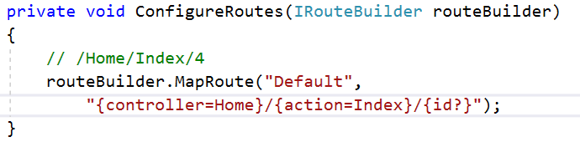
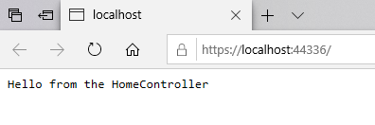
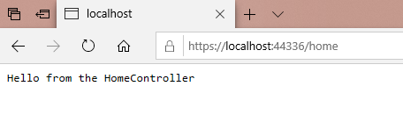
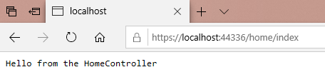
Conventional Routes
Notes:
Conventional Routes
That's because this template is not exactly like the template that UseMvcWithDefaultRoute() would apply.
UseMvcWithDefaultRoute() applies some defaults to these parameters.
Using the equal sign, if this part of the URL does not exist, just assume a default name of Index.
The controller is also optional in the sense that we will provide a default.
If you do not see /something, then just treat the controller name as the HomeController.
With that default conventional route in place, we should now be able to reach the HomeController's index action by going to the root of the website, as well as going to just /home, because the MVC Framework will know that the default action is Index and you can also reach it by fully specifying /home/index. All three of those URLs go to the same controller and invoke the same action.
Now we have quite a bit of flexibility in our MVC application, because we can reach any controller and any action using this simple template.

Slide 11
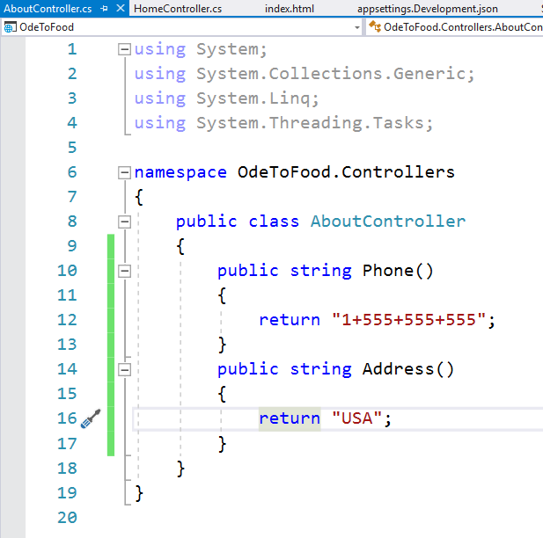
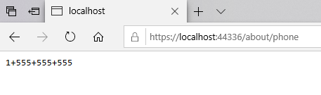
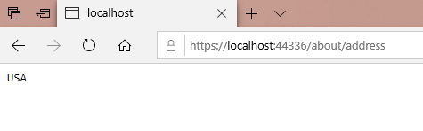
Conventional Routes
Add an AboutController
Notes:
Conventional Routes
So for example, we could go into the Controllers folder and let's add another controller.
Let's call this the AboutController. This would represent about information for the website.
We give this controller an action, let's call it Phone, and return a phone number to contact the owners of the website.
Let's just add in a fake phone number.
We add another action, let's call it Address, that will return some address information.
Save the file and run. How do we reach the AboutController phone action?
We simply go to controller name/action name, which is about/phone and we'll see the phone number displayed.
We can also go to /about/address, and the second action is invoked.
We can now have dozens or hundreds of controllers inside of our application and be able to reach them from a browser and navigate between those actions just by having a properly structured URL /controller name/action.
This is what some people would call the conventional route, or the default route, but let's look at another way to configure routes, one that we can use alongside this conventional templated-based routing, and that is attribute-based routing.

Slide 12
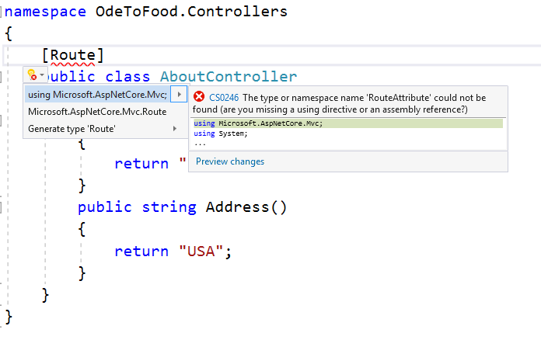
Attribute Routes
Notes:
Attribute Routes
Another way to define routes in an MVC application is to use a Route attribute.
This Route attribute is in the namespace Microsoft.AspNetCore.Mvc. We’ll use Ctrl+period to bring in the namespace.
We also use Ctrl+period to remove namespaces that we’re not using.
We can apply this Route attribute at the controller level.
We can also apply it at an action level.
We specify what needs to be in the URL to reach this particular controller or action.

Slide 13
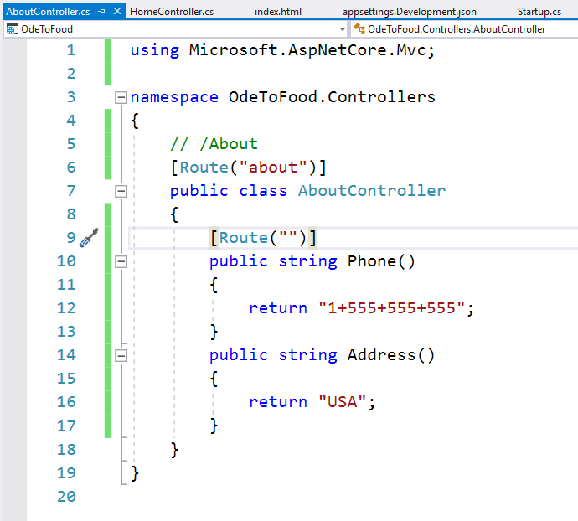
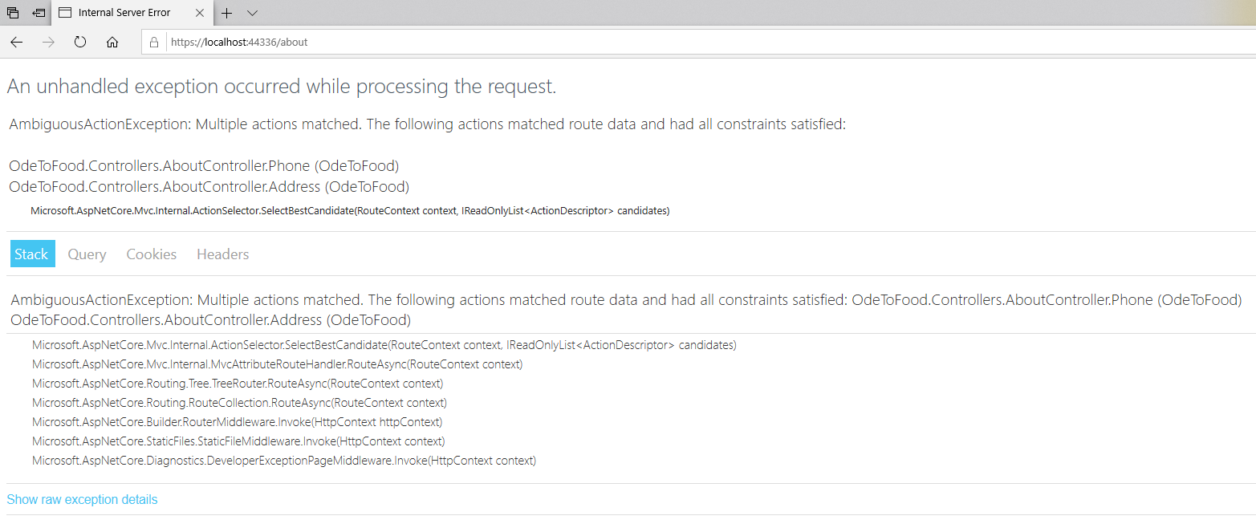
Attribute Routes
Notes:
Attribute Routes
So let's say that we want a request for just /about to reach the Phone action.
Essentially we want the Phone action to be the default action for this entire controller.
That is the type of routing configuration that doesn't work very well with our default route, because our default route says that the default action should have the name Index.
Fortunately, we can combine these attribute routes with the route builder templates, and we can make this work.
The first thing we will do is say that this route for this controller should start with about. We want to see /about in the first part of the URL.
When we would apply a Route attribute inside of the AboutController class (above the Phone Action method), by default, it's hierarchical, so this Route attribute would describe the second segment of the URL.
In our case, we are just going to leave this as an empty string, so if we enter just /about in the url, then invoke this Phone action of this About controller.
Save and let's go to just /about.
There’s an exception that occurs, because the MVC Framework has been able to figure out that it needs to go to the AboutController, because of /about. But inside of this controller, it sees there's two public methods, and the MVC Framework is not sure which one it should execute, so it throws an exception.

Slide 14
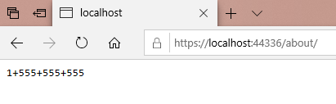
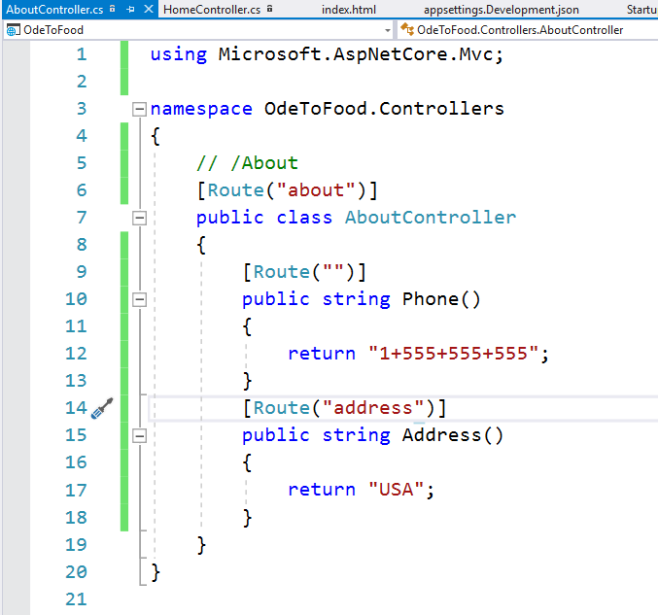
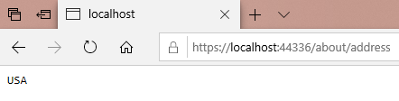
Attribute Routes
Notes:
Attribute Routes
In order for this to work, we either need to be more explicit in our URL, or more explicit with our routing configuration.
If we say that this particular action can only respond when the URL is /about/address, the MVC Framework should be able to differentiate between those two.
A request to /about will invoke our Phone action and return a phone number.

Slide 15
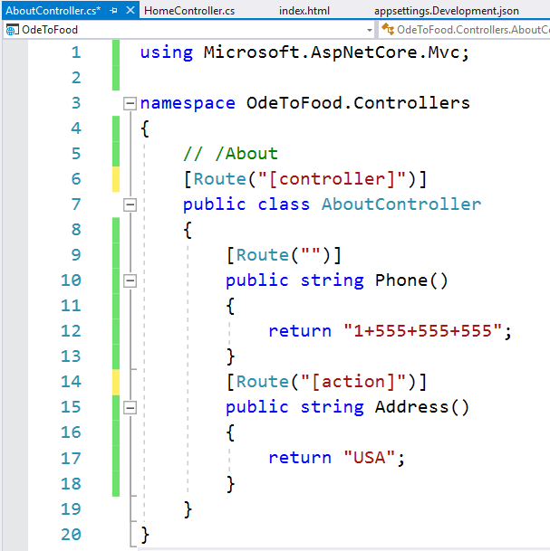
Attribute Routes
Notes:
Attribute Routes
Attribute routes also know about special tokens that can make this type of configuration a little bit easier.
One type of token is the token [controller]. Tokens always appear inside of square brackets, and when we use the [controller] token, that tells the MVC Framework that what appears at the first place in the URL should be the name of this controller About, whatever class that I'm attached to.
This approach can be a little more robust, because now the MVC Framework will know if we rename this class, (let's call it the foo controller), that the route should start with foo.
There's also an [action] token. We can add “action” inside of square brackets, and the MVC Framework will know just to use the name of this method in the URL.
Again, these are hierarchical, so when we have a route inside of a route, it will always be the /controller/action.

Slide 16
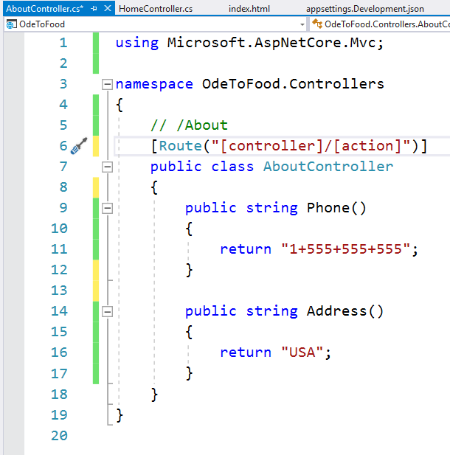
Attribute Routes
Notes:
Attribute Routes
Instead of specifying action everywhere throughout this controller, if it has a few actions on it, there's a better syntax for that where we can say [Route (“[controller]/[action]”), so we always need to see /about/phone or /about/address.
And you can include parameters at the end.

Slide 17
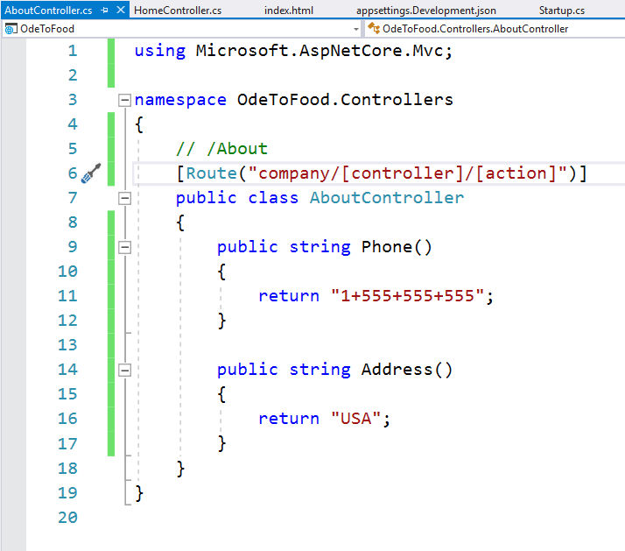
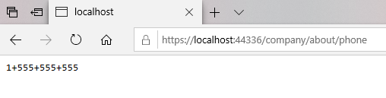
Attribute Routes
Notes:
Attribute Routes
You can also include literal text.
If we only want to respond to company/about/phone, we will add the literal text company to our Route attribute.
Now we would need to go to /company/about/phone to be able to see the phone number.
Again, attribute-based routing is great for those situations where you want to create a route that is specific to a controller or an action inside of controller.
Maybe it needs special conventions, maybe it needs additional parameters that aren't specified inside of the routes inside of Startup.cs, and then some people will avoid the template routes altogether and say that they want to keep all the routing configuration right next to their controllers. So they will only use attribute-based routes, but you can combine them both inside of an application if you want.
So now that we know a little bit more about how to route a request to a controller and to an action inside of the controller, let's start taking a deeper look at controllers themselves and see what functionality they can offer.

Slide 18
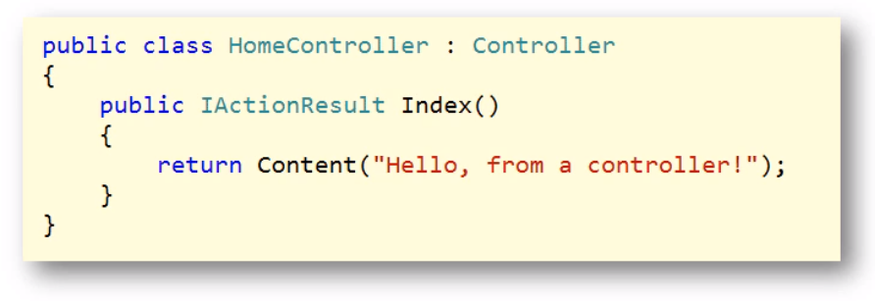
Controller and IActionResult
Notes:
Controller and IActionResult
So far in our project we've been using plain C# classes as controllers.
These classes don't derive from a base class, and although you can use this approach with MVC, it's more common to derive a controller from an MVC controller base class.
This base class gives us access to lots of contextual information about a request, as well as methods that will help us build results to send back to the client.
We can send back simple types like strings and integers, but we can also send back complex objects, like an object to represent a restaurant and all the data associated with the restaurant.
We typically encapsulate these results into an object that implements the IActionResult interface.
There's many different result types that implement this interface, result types that may contain models, or the contents of a file, or a view that will build HTML.

Slide 19
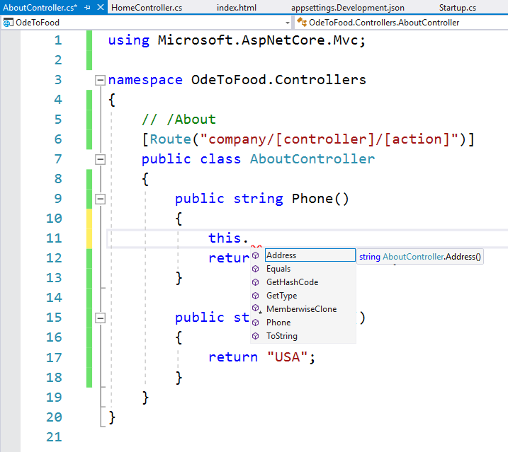
Controller and IActionResult
Notes:
Controller and IActionResult
Let's take a look in the project.
Inside of the Index action of our HomeController (or AboutController), let's use the “this” keyword just to see what's available as an API.
We can see there is not much we can use.
These are mostly just the members that we inherit from our base class, which is currently System.Object. That's the implicit base class for everything that's programmed in.NET.

Slide 20
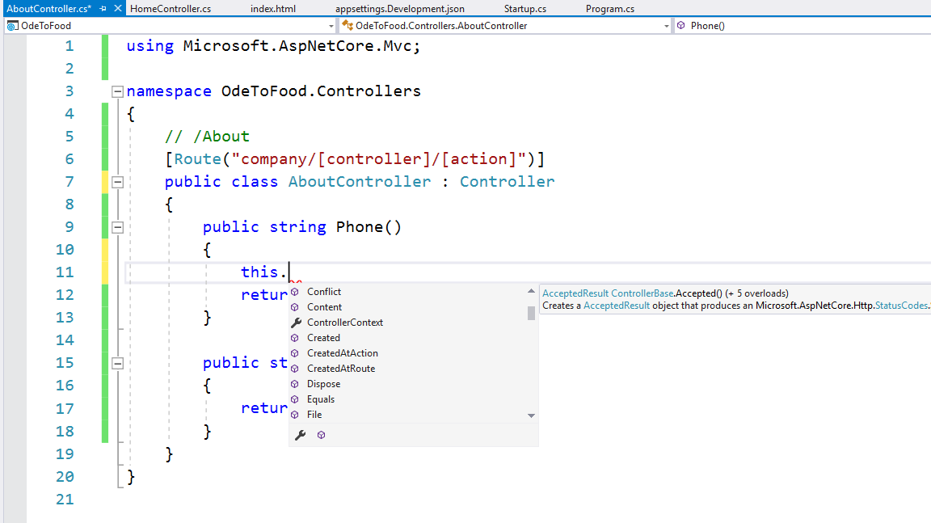
Controller and IActionResult
Notes:
Controller and IActionResult
We can derive from the Controller class that is available in the Microsoft.AspNetCore.Mvc namespace.
Let’s have a look at the members that are available,
We can see we now have a wide variety of methods and properties that are available.
Many of these properties are contextual; that is, if we want to know more about the controllerContext, which includes information about this controller, and even the ActionDescriptor, we can find out things like what is the name of the action that we’re am inside of, what is the name of the controller. (this.ControllerContext.ActionDescriptor.ActionName, this.ControllerContext.ActionDescriptor.ControllerName,…)

Slide 21
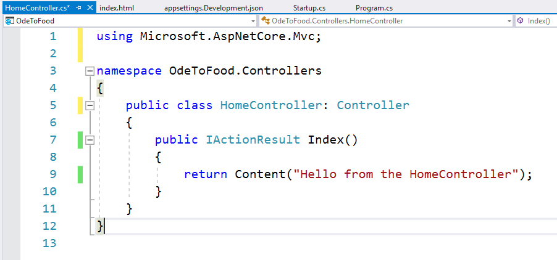
Controller and IActionResult
Notes:
Controller and IActionResult
There is also an HttpContext object (this.HttpContext).
This is the same HttpContext object that is available inside of a middleware request delegate.
We can manipulate the response object (this.HttpContext.Response), we can also look at the request (this.HttpContext.Request), we could look at the headers of the request if we needed to (this.HttpContext.Request.Headers).
We want to warn you that you typically want to avoid using HttpContext inside of an MVC controller.
That's not always possible, but generally speaking, there's usually an easier way to get to things that are in the request or to manipulate the response.
And taking the easier path, which is usually through some feature that the MVC Framework provides, results in code that's a little bit cleaner and also a little bit easier to unit test.
We will see some examples as we move through the course.
In addition to those contextual properties, there's also a number of methods that are available.
The majority of these methods are used to produce something that implements IActionResult.
For example, there's a method, BadRequest(), which we could return this from the method, and this will allow us to build up an object that implements IActionResult that sends back an HTTP status code of 400 to the client.
A 400 indicates an error. We’re telling the client they've made a bad request, perhaps they passed us some invalid data.
There are also methods to send back a file. We can send back a file by providing a byte array or a filestream or by providing the path to a file on the drive.
There's also a helper method here that will allow me to send back content in a more structured manner. And that's the Content method.
So all of these methods that we’re showing you, BadResult, File, Content, these are all methods that will construct an object that implements IActionResult.
If you use this return statement, we will need to change the return type of our method, this is no longer returning a string.
Technically it is returning a ContentResult object, and anytime you're implementing a controller action that returns a very specific type of result, you can always strongly type this return type to the exact type that you are returning.
Many times, and we'll see this in this course, you might need to return different action results, depending on data that the user has provided, and if that's the case, you can always set the return type to IActionResult, and all of these result helpers, Content, File, BadRequest, they all produce objects that implement this IActionResult.
Save this file and run. At the root of the website, which will invoke this HomeController, the client's not going to see any difference.
We’re still responding with a plain text result Hello from the HomeController, but now we are doing this through an action result.
Action results are interesting, because this is an important concept in the MVC Framework, particularly if you want to unit test these controllers.
An action result like Content doesn't immediately write into the response.
It doesn't start sending anything back to the client right away.
Instead we return this data structure, this IActionResult, that tells the MVC Framework what to do next.
Somewhere later in the processing pipeline, the MVC Framework will call this controller action, it produces an action result, and then execute that action result.
The core concept is the concept of separate deciding what to do from actually doing that thing.
What I want to do is return some content Hello from the HomeController, and all our controller action needs to do is decide that that is what we want to do, return that content.
And it's later in the processing pipeline where the MVC Framework actually takes this object, this ContentResult, and turns that into some text that we will send back down over the network.
Put this into an HTTP response message and send it back over the wire.
And the reason this concept is important, this separation of deciding what to do versus actually doing that thing, is that it adds some additional flexibility.
One example is that we can easily test this HomeController and invoke methods and inspect the data structures that have returned without setting up a web server or having any sort of network communication happen.
There's also additional extensibility points in the MVC Framework where you can plug in your own code that inspects every action result that comes back from any controller action, and you might want to do that to log some information or perhaps augment the information that's being sent back in a result, or even change the result in specific circumstances.
That's really why we had this concept of an action result. This is what we are deciding to do. We’re deciding to render some content.

Slide 22
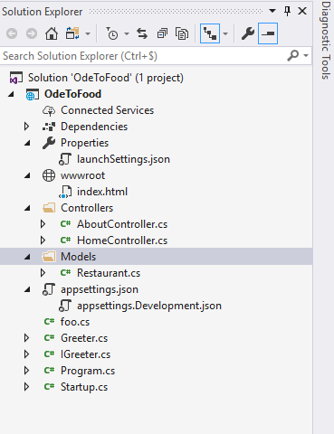
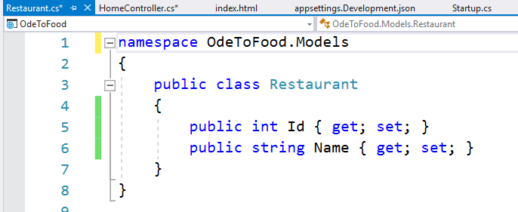
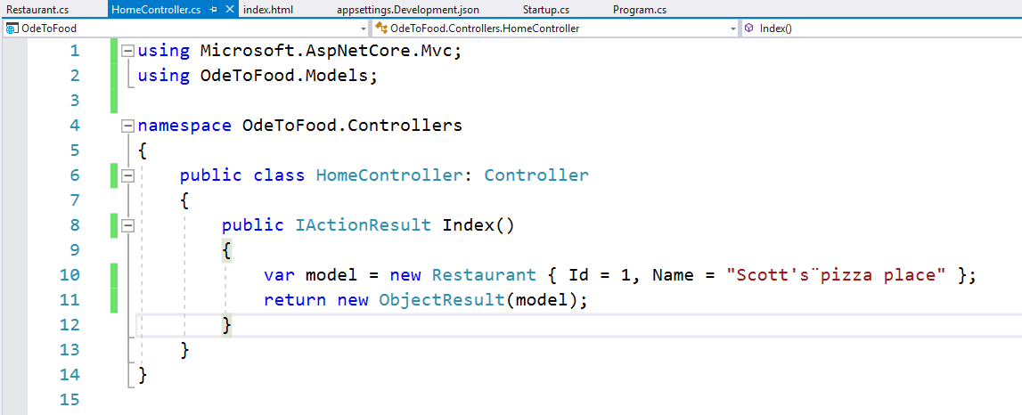
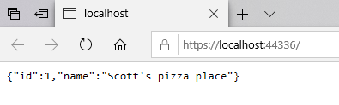
Controller and IActionResult
Notes:
Controller and IActionResult
To give you a specific example of that flexibility, let's introduce a model into our project.
Remember, models are those components that will hold information that we will use to produce a response to the user.
So let’s add a new folder to the project called Models, which isn't required, and by the way, controllers do not have to be in a folder named Controllers, models do not have to be in a folder named Models,
We’re simply using this to make things easy. You can even include models in a different class library project if you want to.
Let's add a class that we can use to represent a Restaurant.
We’re just going to start with a simple couple properties.
Let's give every restaurant an Id, an identifier, and we're not going to hook this up to a database just yet, but later in the course that Id property will be the primary key that we can use to locate a specific restaurant.
Let's give every restaurant a Name.
What we want to do in the HomeController is not just return simple Content, we want to build a model and display that model information somehow.
My model for right now (until we get a database hooked up), we’re simply going to instantiate a new instance of Restaurant, which requires us to bring in OdeToFood.Models, and we'll just hard-code some values here.
So Id = 1, Name = Scott's Pizza Place.
What we want to do is send this model information back to the client.
Let’s introduce a new type of result, which is the ObjectResult.
We can actually use the new constructor to new this up and give it our model An ObjectResult is another one of those results that implements IActionResult.
Notice this name is not very descriptive. This is an ObjectResult. What does that mean?
Are we going to produce HTML, are we going to produce XML or JSON?
Well, in this case, it's not really up to this controller to decide that.
What the controller is saying is the information you want is this Restaurant information.
We’re going to place that information into an ObjectResult, and something else later in the pipeline will figure out what to do with that result.
Let's go ahead and try this in the browser, and what we will see is that we receive JSON in the response.
This is, if you're building APIs, what your controllers would look like.
You'll have a request arrive at the action, typically with some parameters that you can use to retrieve information from another web service or from a database.
You'll use that information to build a model, and then you will return an ObjectResult.
So the controller's decision is to return an ObjectResult.
Later in the processing pipeline, the MVC Framework will say now you have this ObjectResult, you need to send that result back to an HTTP response, what do you do?
It goes up to the ObjectResult and says please write yourself into the response.
What the ObjectResult will do is determine if it should take this model and serialize that model as JSON, or XML, or some other format that you've plugged into the MVC Framework, so it could be any custom format, CSV format, PDF format, images, whatever your application needs.
For those of you that are familiar with the term RESTful APIs or HTTP-based APIs, what ObjectResult is doing behind the scenes is content negotiation.
It is looking at the Accept header that the client sends in the HTTP request, and trying to figure out if the client will accept a JSON result.
In this scenario we’re demonstrating that is exactly what happens.
ObjectResult takes our model, uses a JSON serializer to serialize that object into JavaScript object notation, and we send that back in an HTTP response.
But what if we wanted to take this restaurant and instead of building an API endpoint to retrieve restaurant information, we wanted to build a webpage using HTML to display that restaurant information, that's what we will look at next.

Slide 23
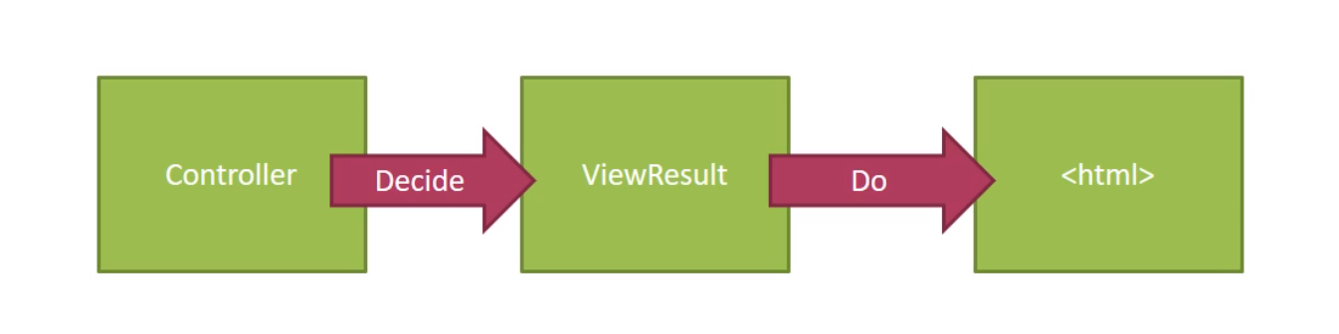
Rendering Views
Notes:
Rendering Views
The most popular method for creating HTML is to use the Razor view engine of ASP. NET MVC.
To use the Razor view engine, a controller action decides to produce a ViewResult object, and a ViewResult can carry the name of the Razor view that we want to render.
A view, by the way, will be a file on the filesystem by default, a file with a .cshtml extension for C#, and this ViewResult object can optionally carry along a model object for the view to use when it creates HTML.
When the MVC Framework sees that your controller has decided to produce a ViewResult, the framework will go out and find the view on the filesystem and then execute that view, which will produce HTML.
It is this HTML that the framework will send back to the client.

Slide 24
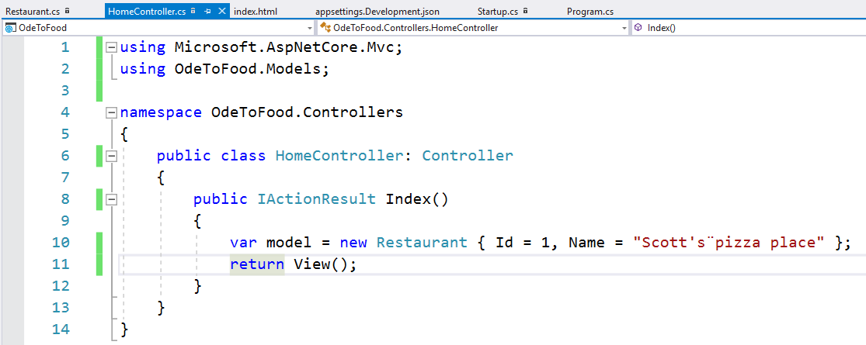
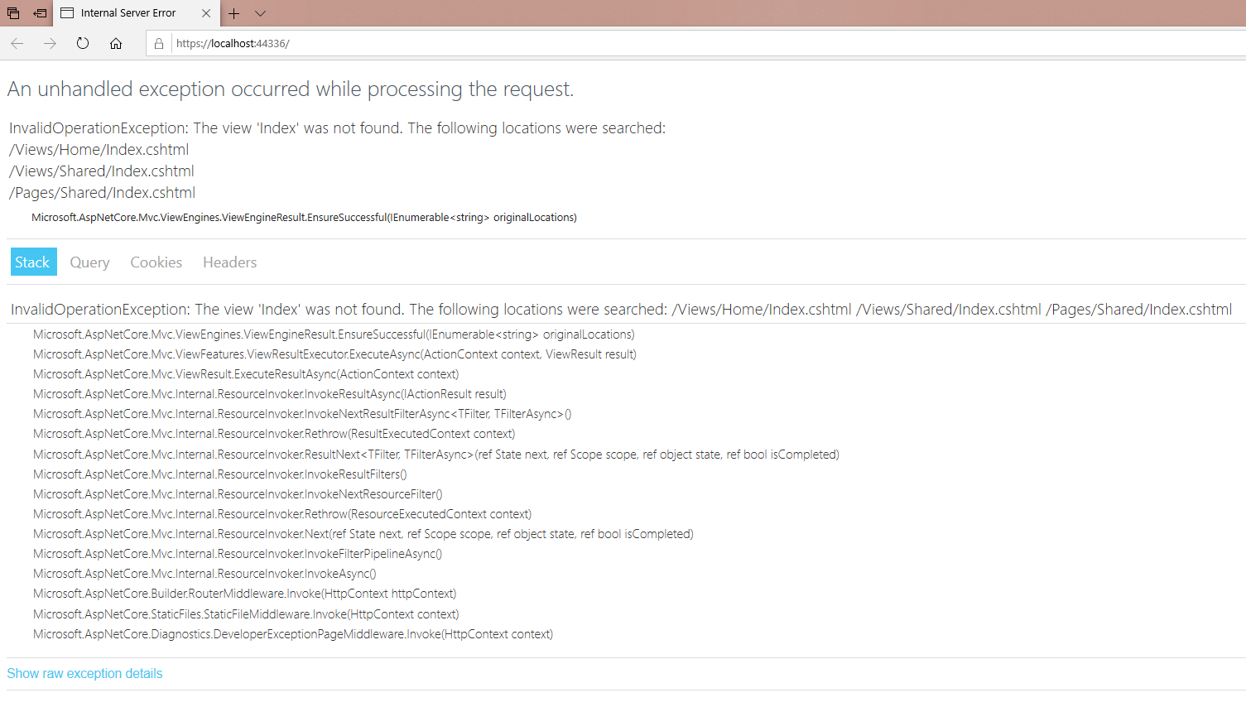
Rendering Views
Notes:
Rendering Views
Inside the Index action, instead of returning a new ObjectResult, we want to call one of the built-in helper methods, which is the View() method.
The View method will return a ViewResult, and that tells the MVC Framework too find a view and render that view.
What we want to do is save this controller and just show you what happens if we refresh the application with no other changes.
The framework returns with an exception, an error.
But this error is very informative. The error tells us that the MVC Framework is looking for a view named Index.
Where did it get the name Index?
If we return a ViewResult and we don't specify a specific name, the framework will assume we want to find the view that has the same name as the action, which returned that ViewResult.
So the action name is Index, therefore, the view name we're looking for is Index.

Slide 25
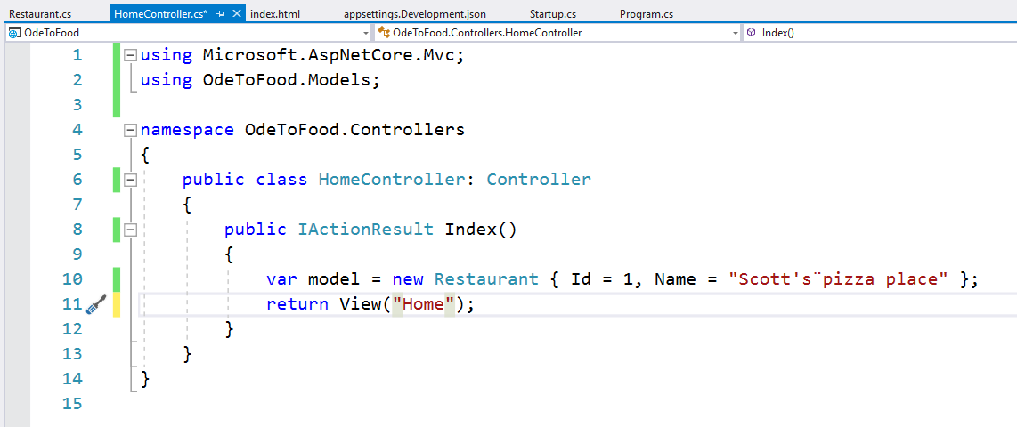
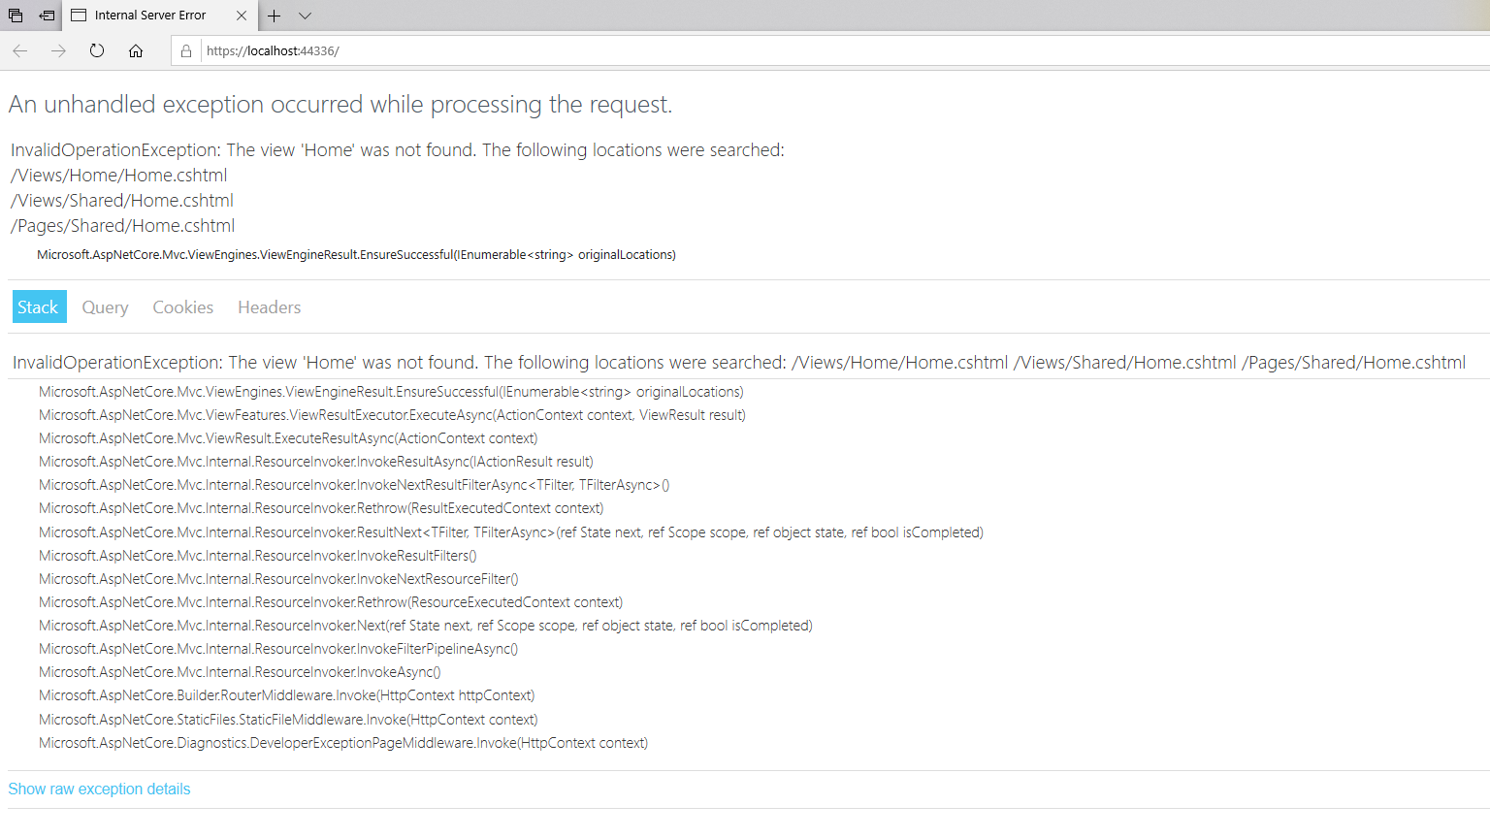
Rendering Views
Notes:
Rendering Views
There's also an overload, so if we wanted to specify a different view name, for example the home view, home.cshtml, the MVC Framework is looking for something called Home.
It also looks for this in a very specific location by default.
This Home.cshtml view has to live either in the Views/Home folder of our project, or in Views/Shared.
When you are creating a view that's only going to be used by a single controller, you would place that in a folder /Views/<name of the controller>.
The name of the controller is HomeController, therefore, we could create this view in the Home folder.
There's also a Shared folder. We'll look at this later in the course.
If we’re creating a view that's going to be used by multiple controllers, we can place that view into the Shared folder to make it easy to find from different controllers.
What we want to do is just return a simple ViewResult using the default name, which is Index, and we want that to render HTML.

Slide 26
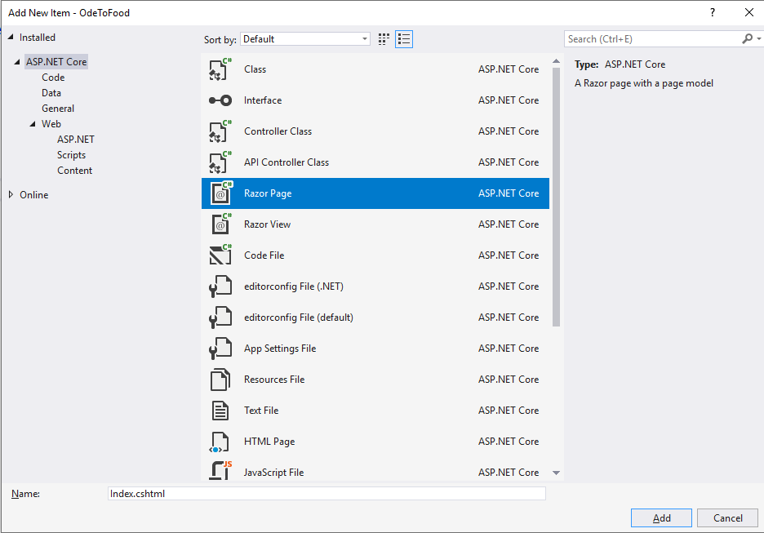
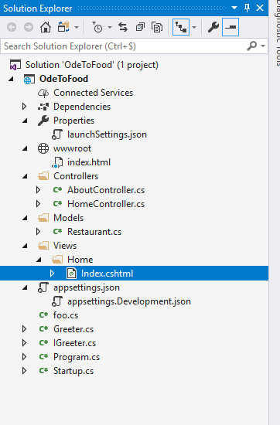
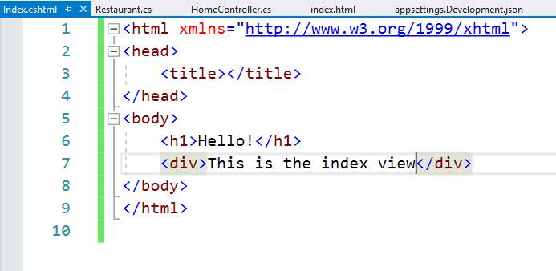
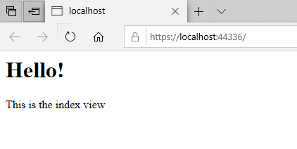
Rendering Views
Notes:
Rendering Views
So we’re going to need to go into our project and right-click to add a new folder.
That new folder will contain the views for our project, and by the way, models and controllers can live anywhere, but Views by default do have to be inside of this Views folder.
Inside of there, we create a folder called Home. All of the views that the HomeController will use live in this folder.
We add a new item, and in this dialog that appears, we choose Razor Page. The default name that Visual Studio selected is Index.cshtml.
Let’s start with delete everything that is in this file, and then use an html snippet.
Type “html” and hit the Tab key, because html is a code snippet that you can use inside of Visual Studio to generate the basic structure for an html page.
Then we have a head and a body, let's go ahead and put in an h1 message. Let's just say Hello.
We can add a div that says This is the index view. Then we save everything and run.
So our HomeController basically said render the default view for the Index action of the HomeController.
The MVC Framework went out and found this .cshtml file, that's the extension for Razor views, found that file, rendered what was inside, produced an HTML response, and that's what we see in the browser.

Slide 27
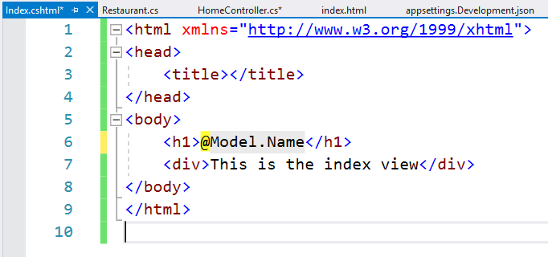
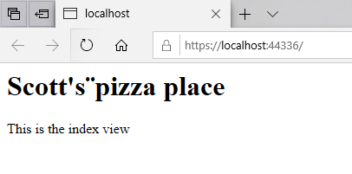
Rendering Views
Notes:
Rendering Views
In fact, we want to take this restaurant information and use that to build our HTML.
In order to do that, we can pass a model object along into the ViewResult, and that ViewResult will take our model object and deliver it to the views so that we can use it there.
Inside of the view, there is a special property that we have access to using the @ sign. That is the Model property, Model with an uppercase M.
So anytime we use an @ sign, we can start writing C# code.
We can write a block of code using curly braces, we'll see that later, or we can just say @ and then some expression.
If we use the “this” keyword again and look at IntelliSense, these are all methods and properties that we inherit from a base class that's provided by the Razor view engine.
One of the properties that we have access to is the Model property, and that Model property will represent the model object that was passed in to the ViewResult.
Since I passed a restaurant to my ViewResult and a restaurant has a name, we should be able to write the expression @Model.Name, which will produce a string with the restaurant name, and that restaurant name should now appear in the HTML output, which it does.

Slide 28
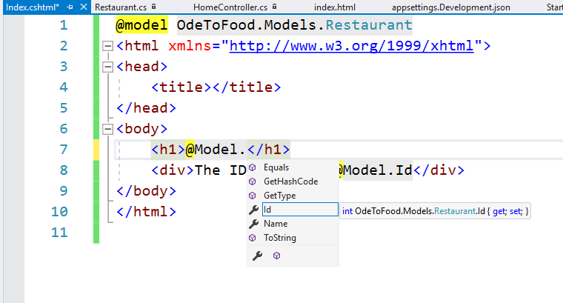
Rendering Views
Notes:
Rendering Views
You'll notice when we said @Model. There's no IntelliSense there to tell me that we have an Id property and a Name property.
That's because in Visual Studio there's no information available to tell Razor or Visual Studio that our Model object will be a Restaurant.
This Model property by default is typed as dynamic, which means we could write any expression here, and the compiler is going to allow that to go through, but at runtime we might not have a foo property.
We want to be able to type Model and actually know that we’re working with a restaurant.
One way to do that is to add a directive to this Razor view, and that's the model directive. This is potentially confusing, but @model with a lowercase m, that is a directive.
Think of a directive as information that the Razor view engine uses to construct the code behind the scenes.
So in a way we’re influencing the code generation for this Razor view.
What we can do with this model directive is tell the Razor view engine the exact type of a model object that should be passed into this view.
You add that this should be OdeToFood.Models.Restaurant. That is the type of model that you should receive.
When we come to our uppercase Model property, this property you'll notice is now typed as OdeToFood.Models.Restaurant, and we should be able to say Model. and see that my model object has a name property and it has an Id property.
We add “The ID value is @Model.Id” to the <div> element.
The whole idea behind Razor, which we'll look at again in more detail later in the course, is that it makes it easy to intersperse HTML, like body and h1 and div, with these little C# expressions that allow us to pick off pieces of the model and display them at the appropriate place in the HTML.
When our users come to the homepage, we know they want to see information about restaurants.
Our HomeController will build a model with the restaurant information that we need to display to the user.
If we want to render that model as HTML, we'll use a ViewResult to describe what Razor view to render and pass along that model object, and then it's up to Razor to accept that model object and mix up HTML with C# expressions to produce the appropriate display for our user.
And what we've just described is the essence of the model view controller design pattern.
The controller receives the request and builds a model.
The model can carry information along to the view.
The controller is only responsible for receiving that request and building the model.
The view is only responsible for taking the model and producing HTML.
And in the end, we have a nice separation of concerns so that our data and our markup and our logic to retrieve data is not all mixed into the same location.

Slide 29


A Table full of Restaurants
Notes:
A Table full of Restaurants
Let's build on the example that we have.
Instead of displaying a single restaurant, w want to display multiple restaurants, because by the end of this course we will have a Microsoft SQL server attached to the application.
The SQL server database will contain multiple restaurants, and when the user comes to the homepage of the website, we want to display all the restaurants that are in the database.
In order to do this, we’re going to go ahead and set things up so that it will be easy to do this when we switch over to SQL Server.
What we want the HomeController to do is to talk to a service that we’re about to define and tell that service to get all the restaurants that you have.
Let’s create a new folder in the project, Services. This can be a folder where we define all the services that our application needs, including IGreeter.
Once we do that, we will want to open up IGreeter and make sure the namespace is consistent with the folder that we are inside of, because in. NET and C# Projects, the convention is to use the same namespace as your project structure.
So IGreeter is in the folder OdeToFood/Services, so we will make the namespace OdeToFood.Services.
That means we'll need to fix up some using statements in other parts of the application inside of Startup.cs, but we'll do that later.

Slide 30


A Table full of Restaurants
Notes:
A Table full of Restaurants
For right now, we want to add another class, actually an interface, IRestaurantData.
Because just like with the greeter, we want our controller to talk to a service through an interface definition.
That makes it easy for us to swap out the actual implementation of the service at test time or at runtime.
All this interface needs to do is to define all the operations that we need to retrieve and update and delete restaurants.
The only thing we want to do right now is retrieve all the restaurants.
So let’s add a method to IRestaurantData called GetAll(), and what this can do is return an IEnumerable of Restaurant.
We will need to bring in the namespace OdeToFood.Models.
With our interface definition in place, let’s add an implementation using a class, and we will call this InMemoryRestaurantData.
Because later in the course, we will be hooking up to a SQL Server database.
We'll see how to use the entity from from ASP.NET Core, but for right now to keep things simple, we’re just going to hold a list of restaurants in memory, and we'll just display some restaurants that we have hard-coded inside of this class.
We create a private field, a list of restaurant, and again, bring in the namespace. We'll call this _restaurants.
To initialize that list, we will add a constructor, so use the ctor code snippet, press Tab, and we want restaurants to be a new list of restaurant.
We add some restaurant names:
A new restaurant with an Id of 1, and the name Scott's Pizza Place.
Another restaurant with an Id of 2, a name of Tersiguels.
And 1 more restaurant, Id of 3, name equals King's Contrivance.
We just need in-memory restaurant data to implement the interface IRestaurantData, which will require us to have a method GetAll().
We used Visual Studio to generate that method with Ctrl+period.
We are going to move the field declaration down to the bottom of the class definition, that would be where we like to see private fields declared.
The implementation of GetAll() is very simple.
All we need to do is return this collection of restaurants that we have.
We could even throw in some link statements to do a query to get a given a restaurant we want to order by the name of the restaurant, that will be ascending order by default.
We do want to caution you that you have to be very careful when you're using an abstraction like this that contains a list, because a list is not thread-safe, and if we were to use InMemoryRestaurantData, a single instance across multiple requests, we can run into some threading issues.
But we’re not going to address those issues in this class, because we’re going to assume that we only use InMemoryRestaurantData for testing or development.
Later when we build an implementation of IRestaurantData that does talk to SQL Server, we won't have to worry about holding an in-memory list, and we won't have those threading issues.

Slide 31

A Table full of Restaurants
Notes:
A Table full of Restaurants
How do we use InMemoryRestaurantData or IRestaurantData from our controller?
We typically just want to rely on ASP.NET Core to inject services into the components where we need them.
In the Configure method, we're injecting ILogger and the IGreeter, and since IGreeter was a custom service, we had to register IGreeter inside of ConfigureServices.
We’re going to do the same thing with restaurant data.
First we need to bring in the namespace OdeToFood.Services.
That will allow us to access IGreeter and IRestaurantData.
Instead of using AddSingleton, we’re going to use AddScoped so whenever someone needs an instance of IRestaurantData, let”s give them an instance of InMemoryRestaurantData.
AddSingleton is a way of telling ASP.NET Core if any component across the entire application needs an IGreeter, give them an instance of Greeter and use the same instance throughout the application everywhere for every request.
Scoped is just a way of telling ASP.NET Core any component that needs IRestaurantData create an instance for each HTTP request and reuse that instance throughout that one request.
After that, you can throw it away and create another instance for the next request.
That is an HTTP Scoped lifetime for our service, and that's typically what you would want for a data access component.

Slide 32


A Table full of Restaurants
Notes:
A Table full of Restaurants
With our service defined and our service registered with the service collection in ASP.NET Core, let's go to the HomeController, and one way to get access to the service is to write a constructor and to say we need an IRestaurantData service.
Let's call that restaurantData.
All we need to do here is bring in the namespace, OdeToFood.Services, and when the framework knows that a request is going to the HomeController and it needs to create an instance of this controller for that request, and by the way, that controller instance is only used for one single request, then the framework is also smart enough to look at this constructor, see that this constructor is requiring a service, and the framework will go to a service provider and say, do we know what an IRestaurantData is, can we have also an instance of that?
Which, since we registered this properly, shouldn't be a problem.
So let’s take this incoming restaurantData object and save it into a new private field _restaurantData, and inside the Index method, instead of hard-coding the model, we’re going to the restaurantData and tell it to give us all the restaurants.
What's interesting about this approach, what we'll see later in the course is that when we do switch over to using a real database instead of an in-memory collection, we will not need to change any code inside of this controller.
All it needs to know is that it is getting something, some object that implements IRestaurantData and that will deliver IRestaurantData.
Before we go any farther, let me save all the files and come back to the browser and refresh, just to show you that the Razor view engine is going to complain and tell us that what we passed into the view is an OrderedEnumerable of restaurant, that is, a collection of restaurants. But what the view requires is a model type of a single restaurant. And that is because of the @model directive.
We’re telling the framework we need a single restaurant, but we pass in a collection of restaurants, therefore, we see a runtime error.

Slide 33


A Table of Restaurants
Notes:
A Table of Restaurants
That's easy enough to fix.
We just need to say that we take any IEnumerable of Restaurant.
That could be a list, an ordered enumerable, an iqueryable, there's dozens of interfaces in .NET that implement IEnumerable.
At this point, we can pretty much work with any collection.
Instead of displaying a single restaurant, let us use a code snippet for table and press Tab.
What we want to do is have one table row for each restaurant, and in Razor, we can use a foreach C# statement.
So again, the @ sign to switch over into C# mode, and we could say foreach restaurant that is in the Model (so uppercase M to reach the Model property), we want to execute the following code.
And the following code will actually be a mix of C# expressions and HTML markups.
What the Razor engine is going to do is see you're writing a loop, a foreach loop, around this block of HTML, and what Razor will do is stamp out a copy of this tr tag once, or each restaurant in the model.
Razor is also smart enough to switch between C# mode, which is our foreach statement and an opening curly brace, and switch back into literal HTML mode when it sees the opening tr tag, and then I can switch back again into C# mode.
So, we will be looking at Razor in more detail later in the course.
In addition to expressions like restaurant.Id, which will output something into our HTML, we can also have C# code blocks, code blocks like foreach statements, for statements, if statements, and with any sort of looping construct like this, We'll be creating multiple copies of this HTML snippet.
We want to write out the restaurant Id, and then inside of another table cell, let's write out the restaurant.Name.
With those changes in place, we should be able to save index.cshtml, refresh this page, and although the user interface is not that pretty, we now have all the restaurants that we know about displaying on this page and sorted alphabetically.

